Slide 1

HI 👋
I'M VEYSEL AKSIN
Software Enginner Lead @Trendbox

Slide 2
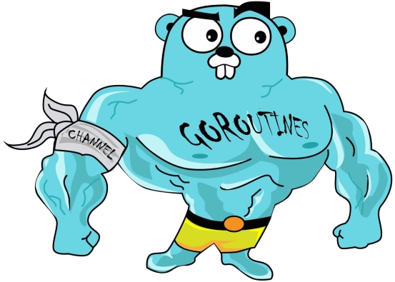
Concurrency: Goroutines & Channels

Slide 3
TABLE OF CONTENT
Concurrency
Concepts to Know
How is Concurrency Managed in Go?
Goroutine
WaitGroup
Channels
Unbuffered Channels
Deadlock
Buffered Channels
Some Patterns
Select

Slide 4
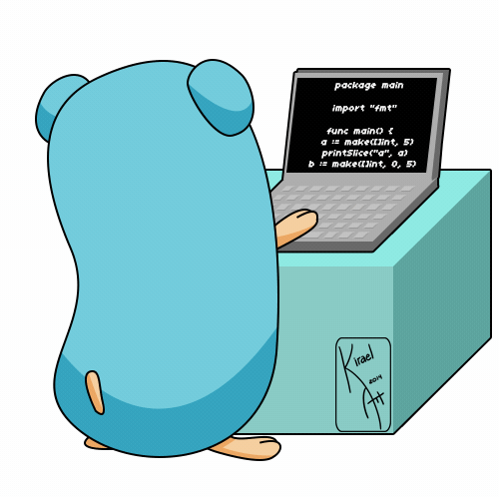
CONCURRENCY
Running a part of the program independently and simultaneously is called concurrency. So, concurrency is the capability to deal with lots of things at once.
Example;
Let's imagine a gopher writes code. When another gopher enters the room and greets him, he will stop coding and wave to his friend and continue coding.

Slide 5
Concepts to Know
There are some concepts that need to be known to better understand the concept of concurrency. If we know the concepts of parallelism, async and sync, we will understand the difference of concurrency.
Sync: Processes occur sequentially and in a single thread, one process does not start until the other one finishes.
Async: Processes execute independently and in parallel, one process does not wait for another to finish.
Parallelism: Multiple processes run simultaneously on multiple threads.
Concurrency: Multiple processes are started and managed simultaneously, by performing context switching between them.

Slide 6
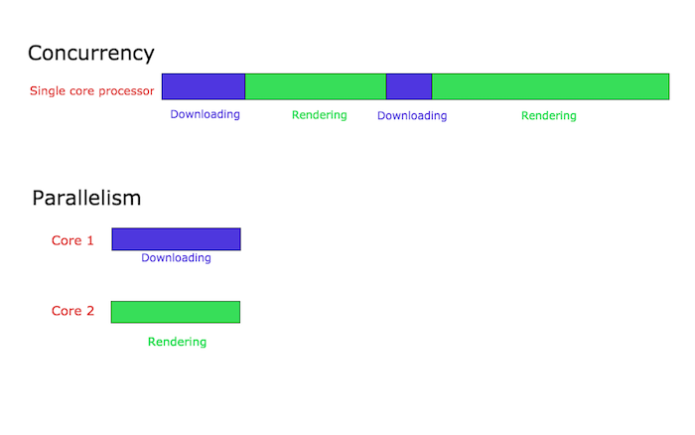
Is Concurrency Parallelism?
Concurrency is not parallelism.
- Rob Pike

Slide 7
How is Concurrency Managed in Go?
Go uses a strategy called CSP, or Communicating Sequential Processes, dating back to the 1979s. The ancestor of CSP is British computer scientist Tony Hoare, born in 1934.
Go organizes process scheduling tasks itself, without leaving it to the operating system. It maintains a queue called Local Run Queue and organizes concurrent jobs thanks to this queue. In this way, a single thread is enough for go!
These concurrent work tasks are done with goroutines.

Slide 8
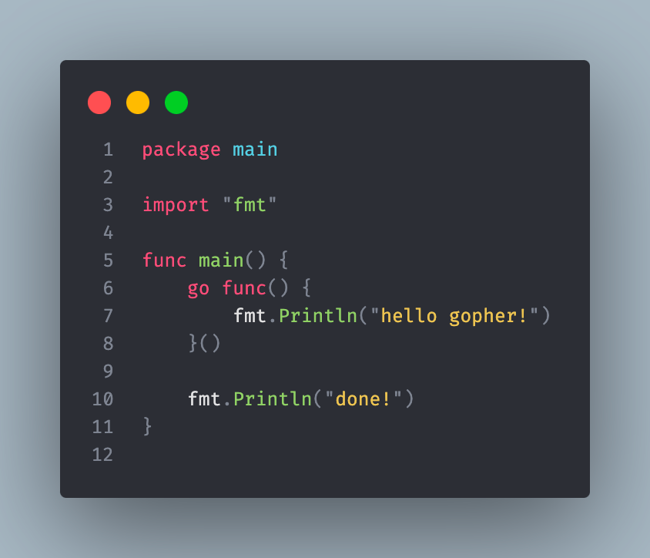
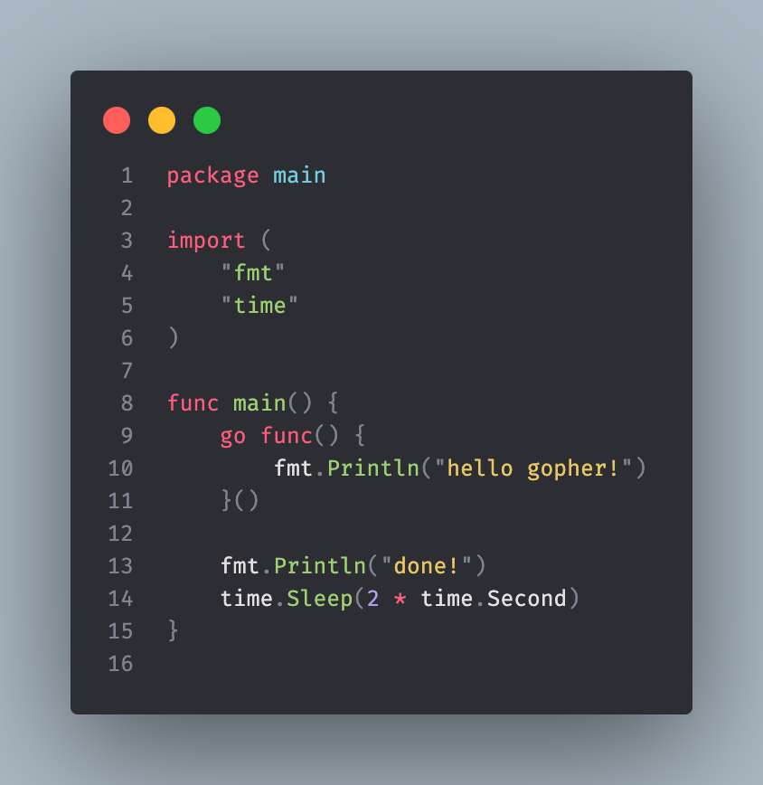
Goroutine
Goroutines are lightweight processes managed by the go runtime.

Slide 9
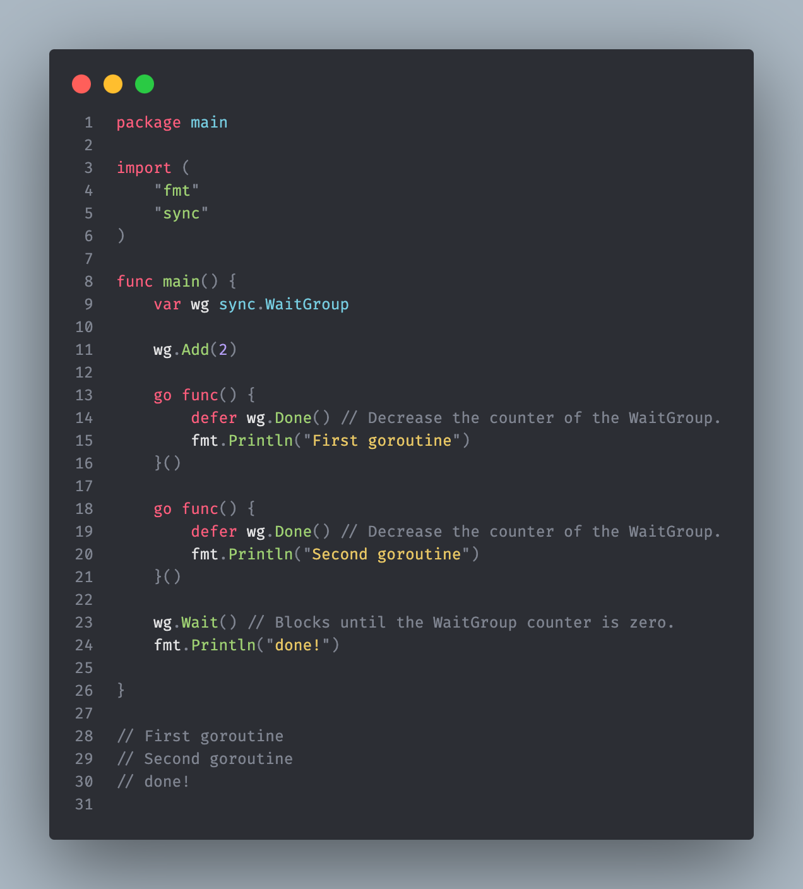
WaitGroup
WaitGroup is used to wait for concurrently running goroutines to complete. The Done() method marks the end of the WaitGroup and says “hello gopher!” prints the message. Wait() waits for the WaitGroup to finish. This line waits for the goroutines in the WaitGroup to complete before moving on to the next step.

Slide 10
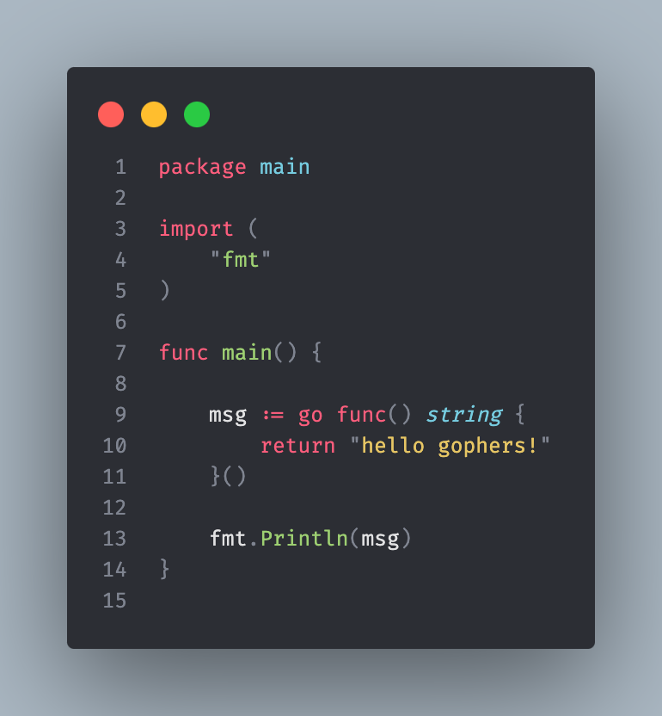
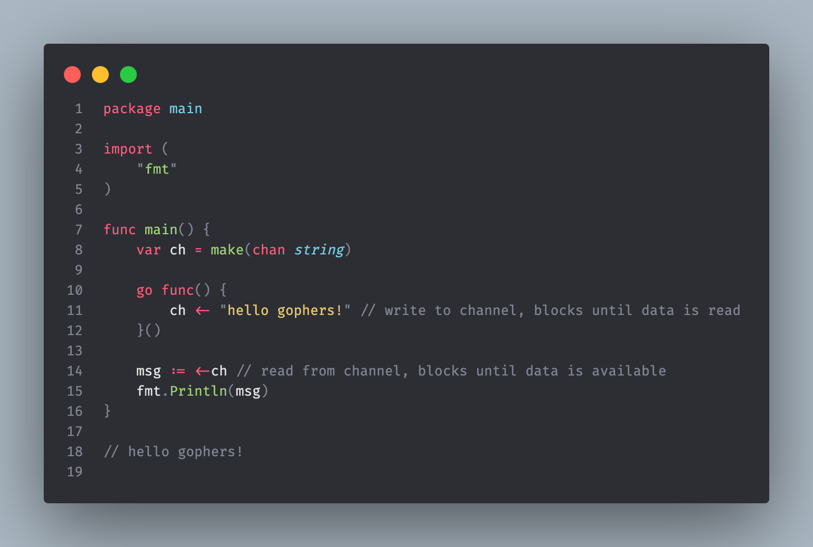
How to Communicate with Goroutines?
Goroutines communicate among themselves through channels.

Slide 11
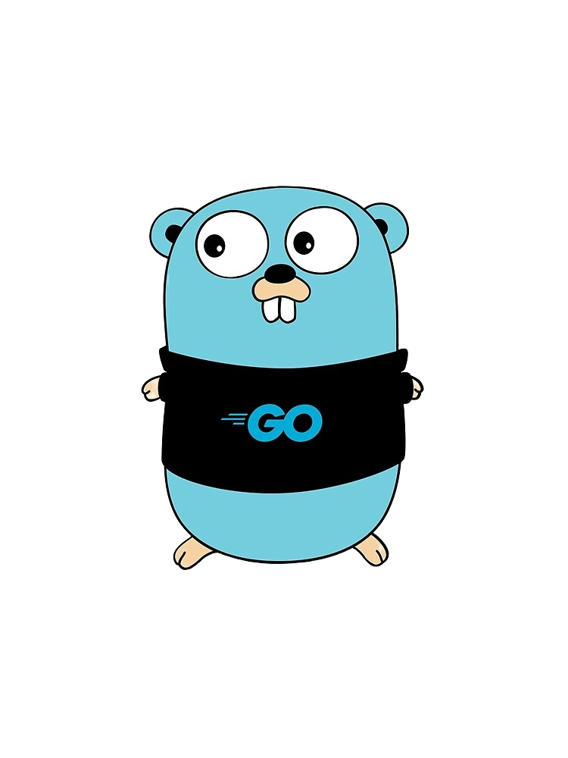
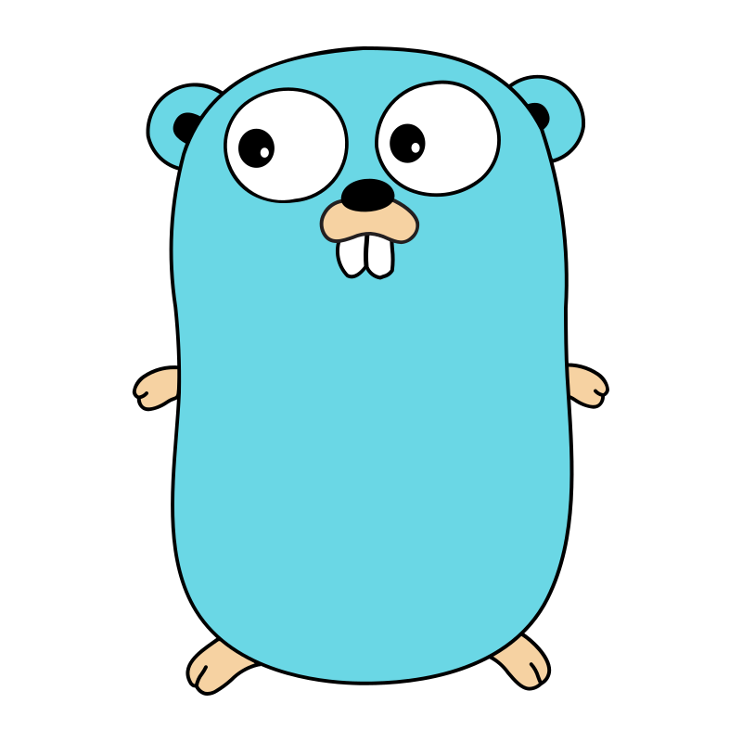

CHANNELS
Channels are built-in data types that allow data to be carried between goroutines.
Any non-goroutine function can return a value, but with goroutines the situation is slightly different. You cannot return a value in goroutines, but you can share the information contained in the goroutines using channels.
Channel
Hi Gopher
OK

Slide 12
CHANNELS
Multiple goroutines can write/read to the same channel.
Channels are created with the chan data type.
By default, channel read/write are synchronous operations.
Assigning a value to Channel is like passing a parameter to a function.
It is necessary to be careful when passing reference types (pointer, map, slice, etc.) to the channel. Because it is highly likely to be data race. In other words, if one goroutine is reading a value and another goroutine tries to assign a new value, the situation becomes a race-condition.

Slide 13
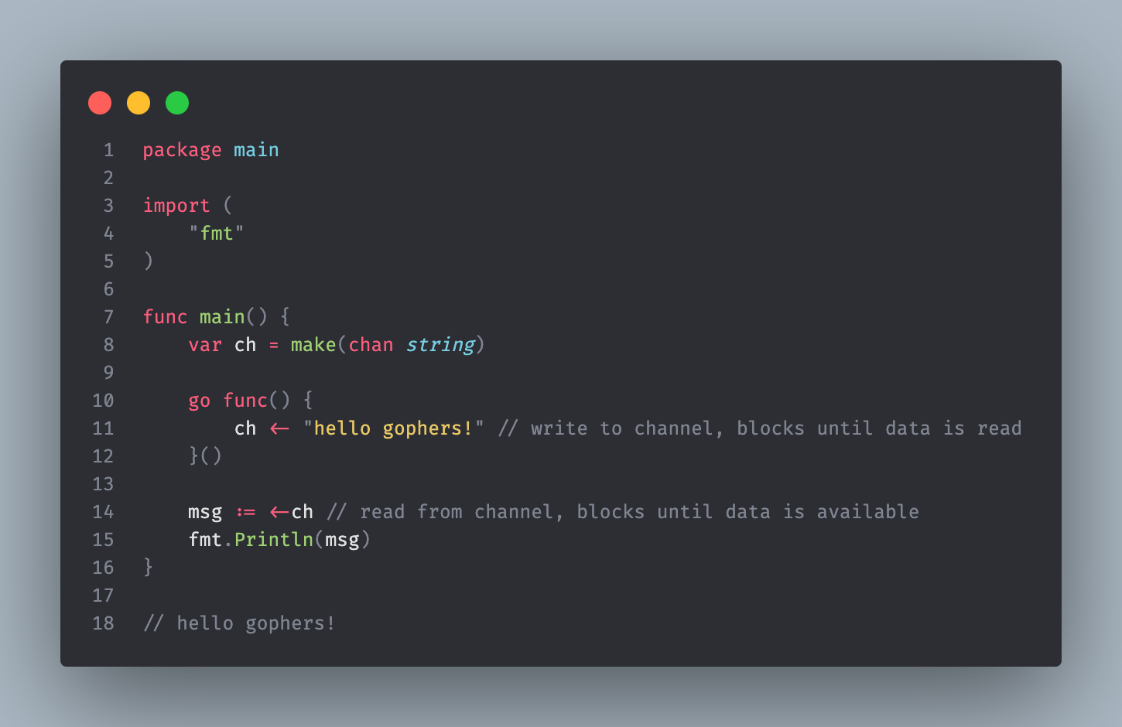
Unbuffered Channels
Unbuffered channels operate synchronously.
Unbuffered channels are defined without specifying size.
If the channel is unbuffered, the sender blocks until the receiver has received the value.

Slide 14
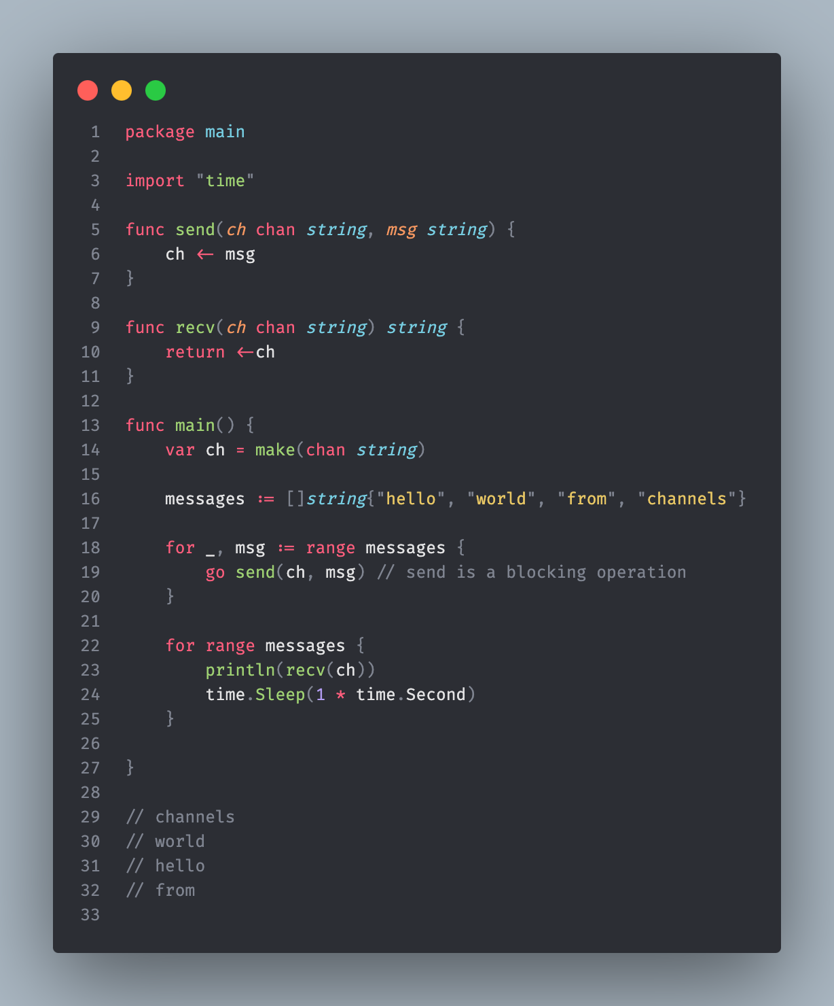
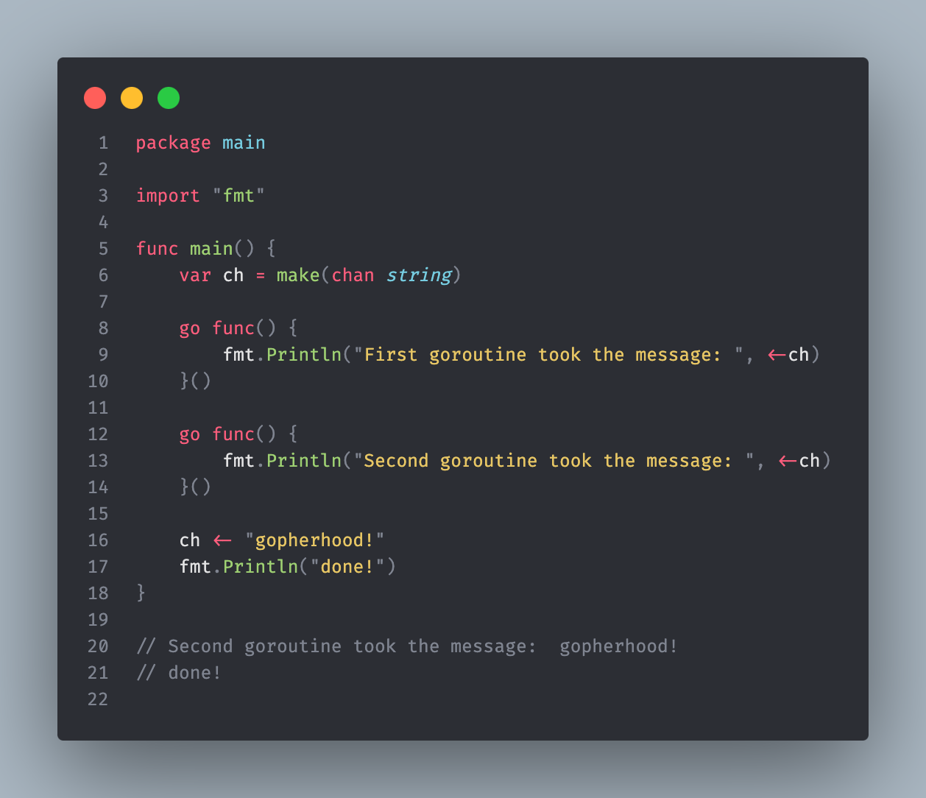
Unbuffered Channels

Slide 15
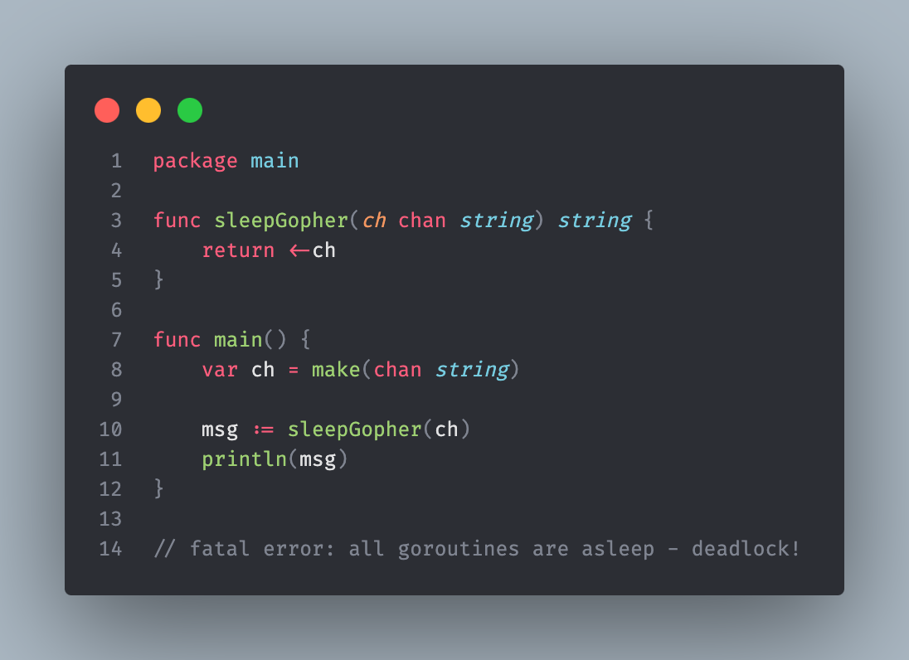

Deadlock
If no one writes to the Channel, those who want to read will be stuck in the air and wait in vain. In this case, the goroutines fall asleep
fatal error: all goroutines are asleep - deadlock!

Slide 16
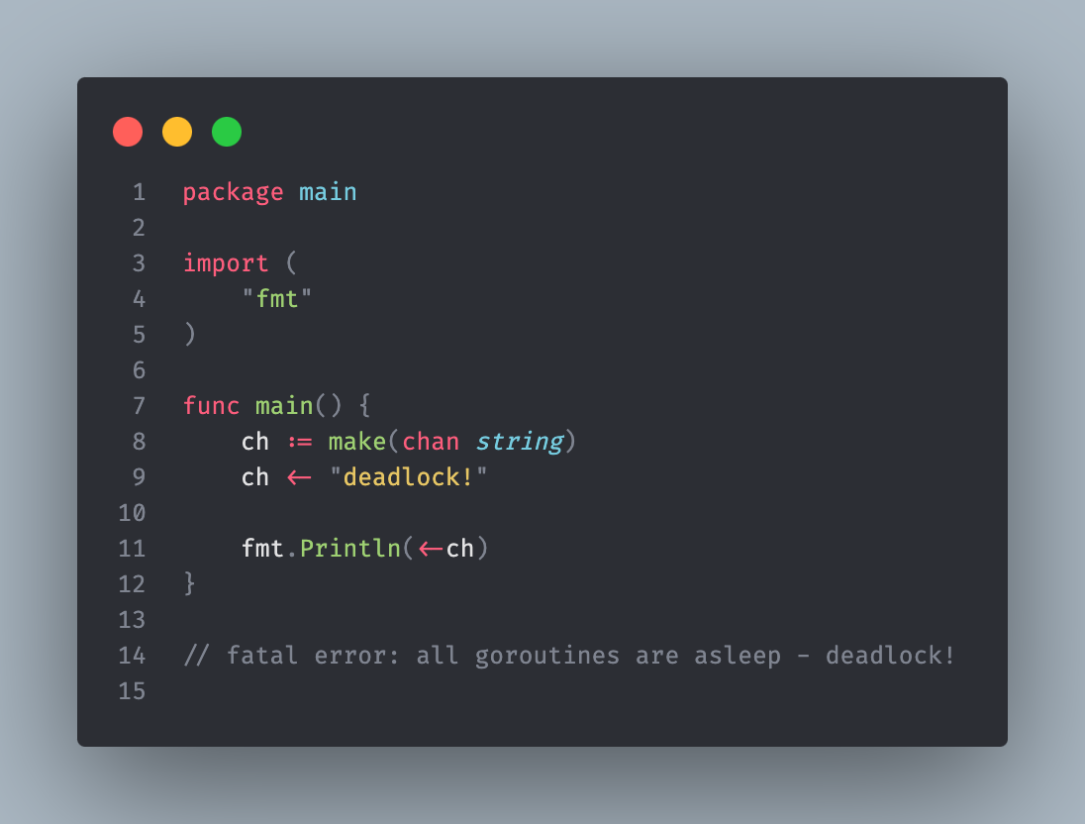
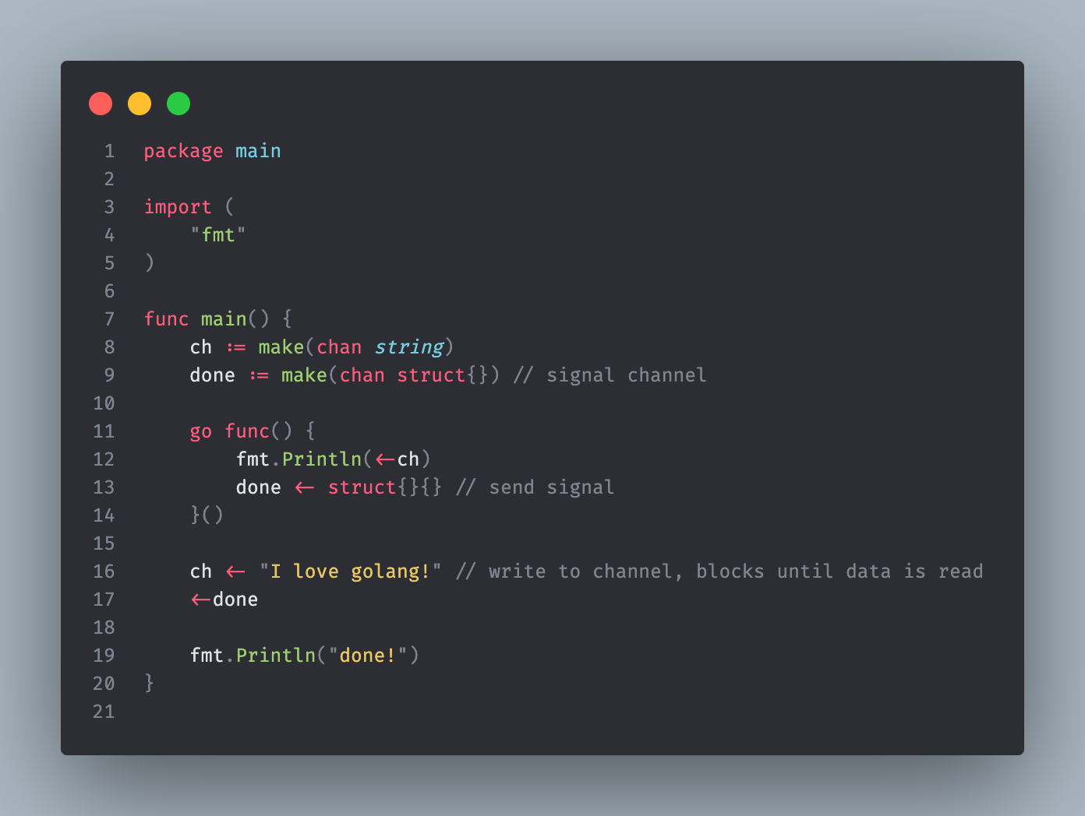
Deadlock

Slide 17
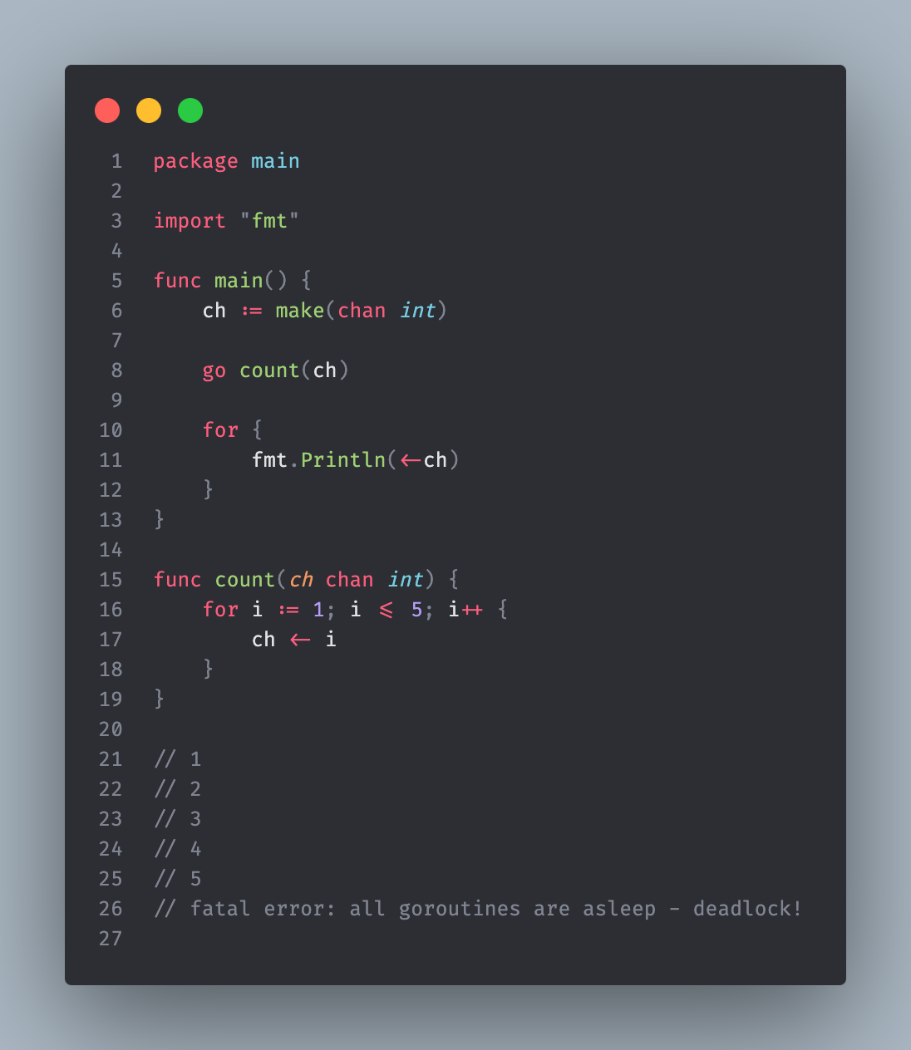
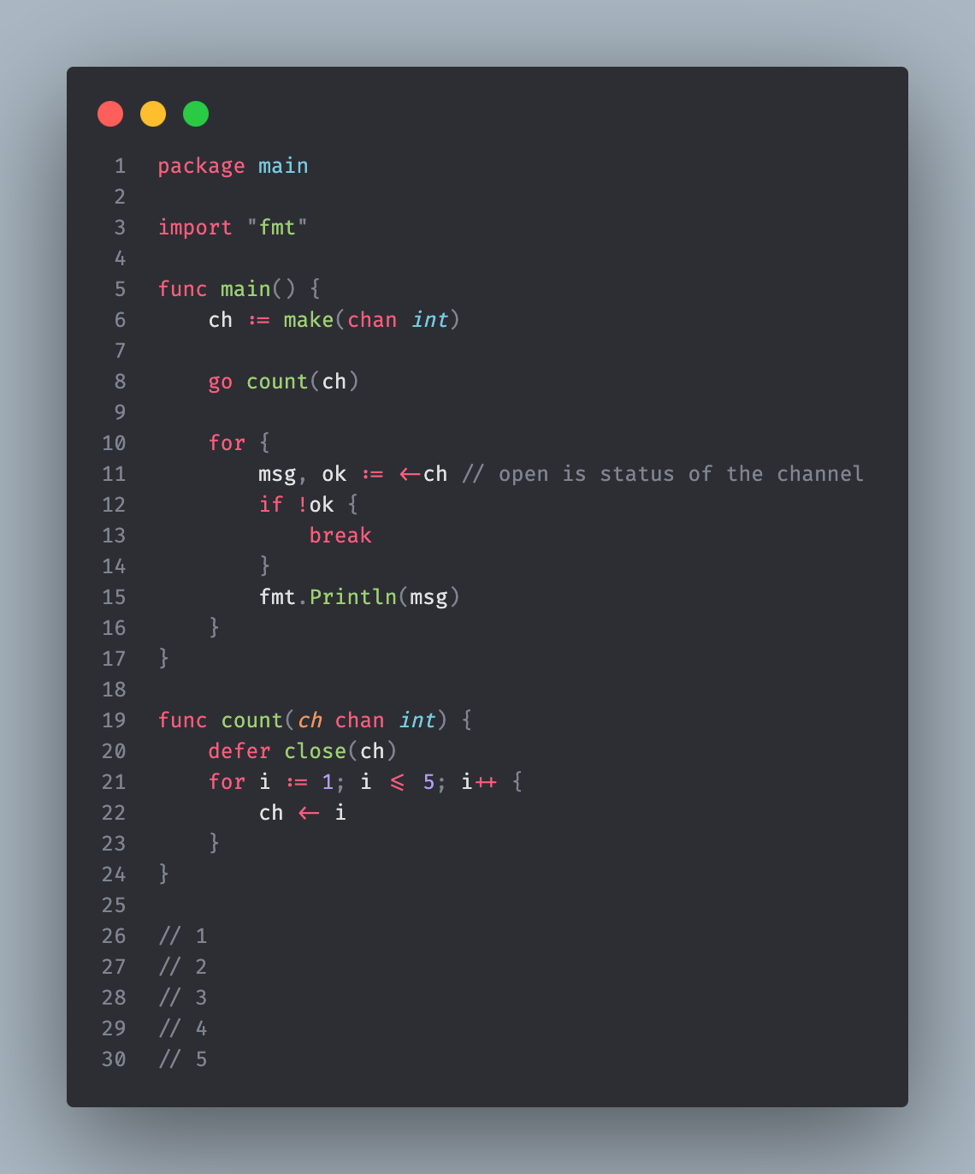
Deadlock

Slide 18
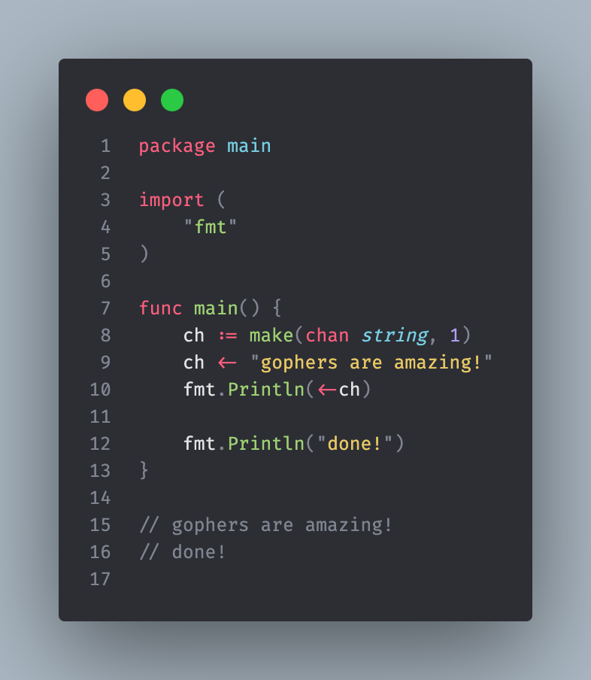
Buffered Channels
Buffered channels operate asynchronous.
Buffered channels are defined with specifying size.
Depending on whether the buffer is empty or full, the blocking process works differently compared to other unbuffered channels.

Slide 19
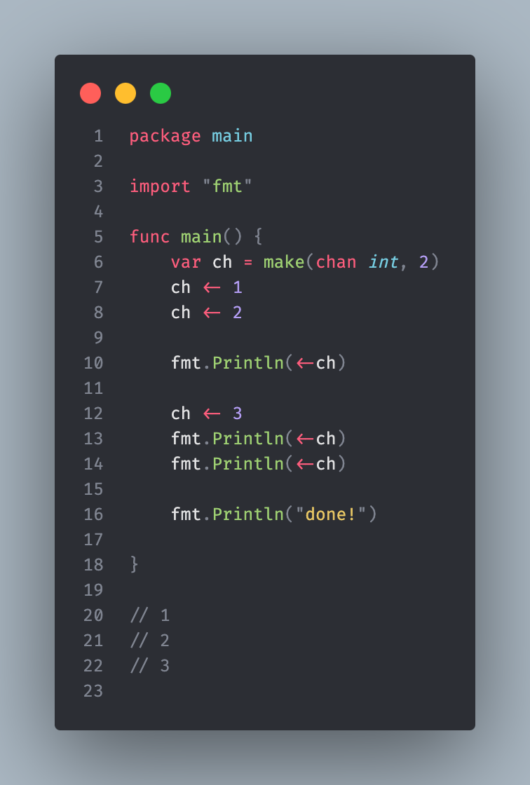
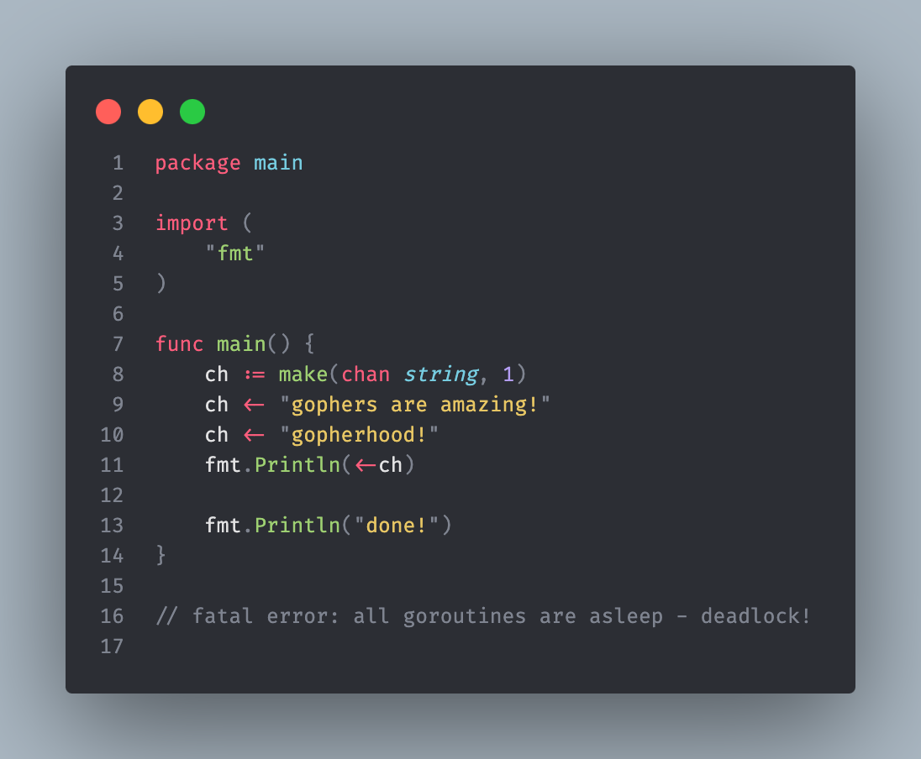
Buffered Channels

Slide 20
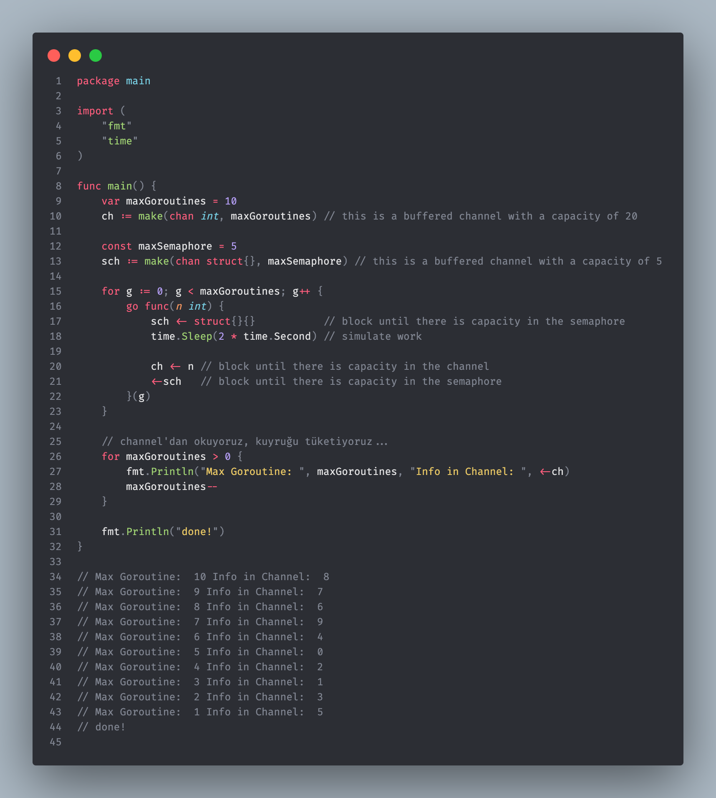
Semaphore Pattern
The semaphore pattern is a design pattern used to enable resource sharing in concurrent programming. This pattern is used to control the values at which a particular resource can be accessed simultaneously. Semaphore is a type of counter used to limit goroutines' access to a particular resource.

Slide 21
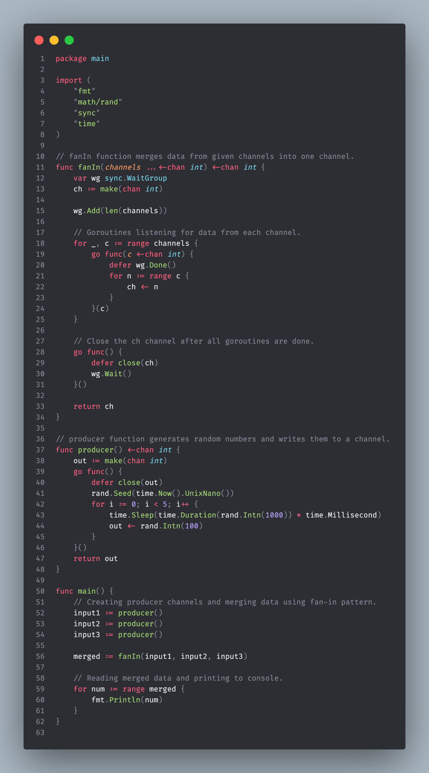
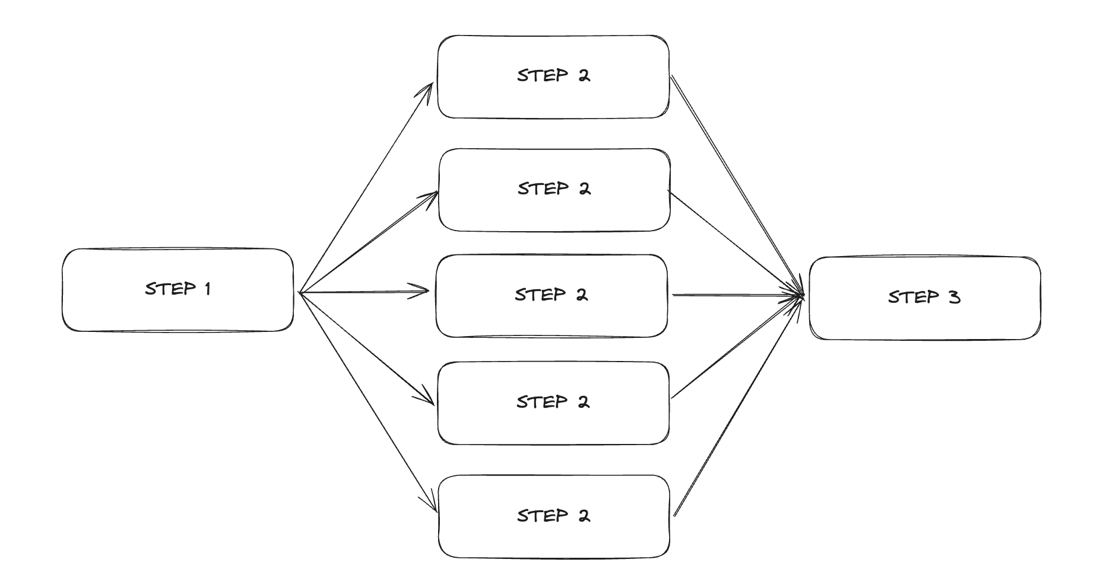
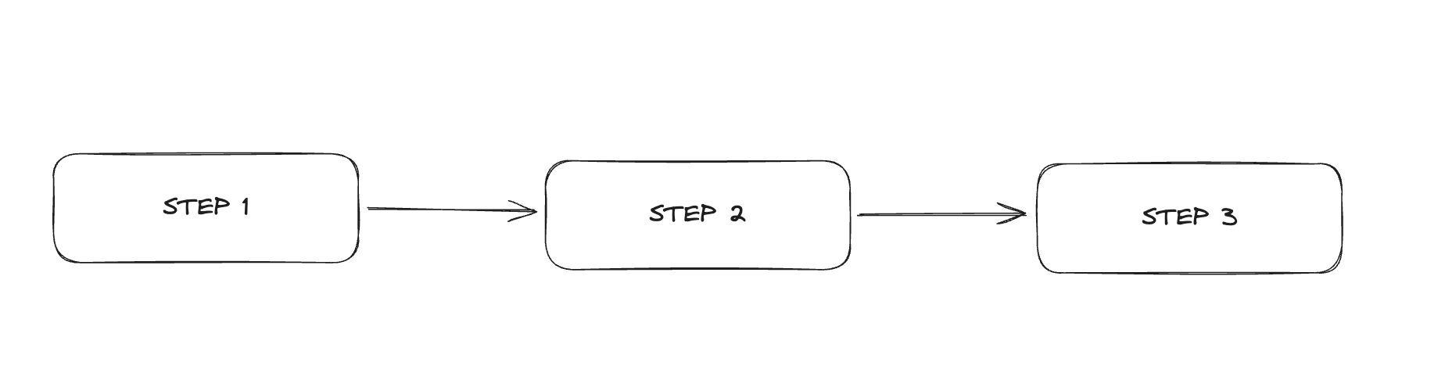
Fan In / Fan Out Pattern

Slide 22
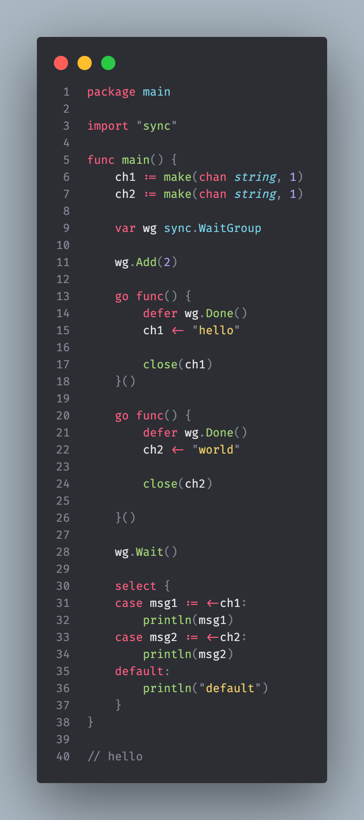
SELECT
It is used to listen to multiple channels at the same time.
It is very similar to the switch case structure.

